Slide 1
FINAL TEAM PROJECT
Sushma ParAmeshappa
Sheetal Singh
Vinusha Reddy

Slide 2
Objective
Data Modeling in Toad Data Modeler.
Querying in MySQL, Oracle and SQL Server 2014.
Exporting and importing data from one database to another.
Creating and deploying OLAP cubes.
Generating reports in Power BI.

Slide 3
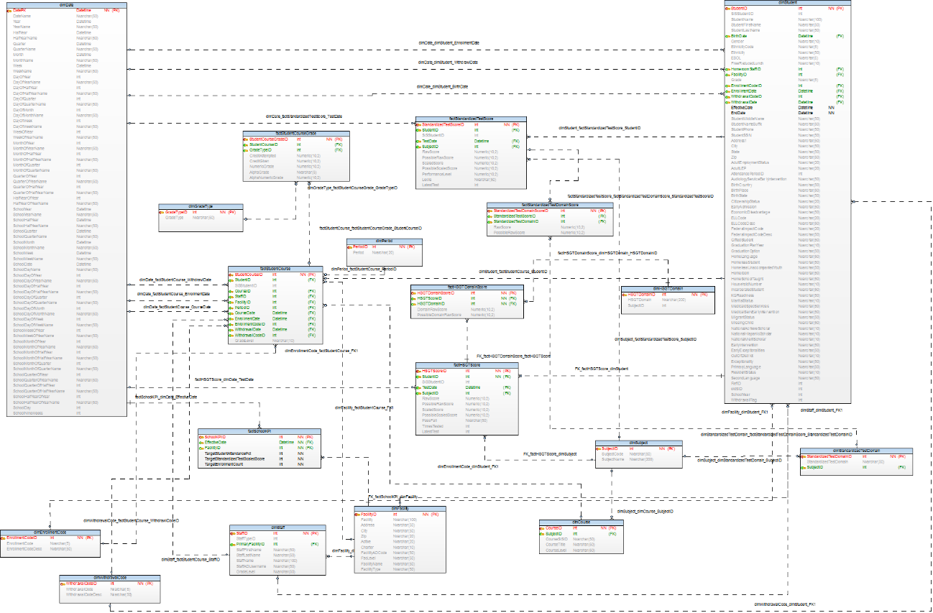
Data Model

Slide 4
EXPORT AND IMPORT DATA
Reverse Engineering of database in Toad Modeler.
Generate DDL Script for specific database.
Export data from SQL Server 2014 in Microsoft Excel.
Run the script in the selected database.
Import data.
Execute queries.

Slide 5
OLAP CUBES
Define Data Source.
Define Data Source View.
Define Dimensions.
Define the cube.
Process and deploy the cube.

Slide 6
REPORTS
Import data from OLAP cube in Power BI.
Analyze the data.
Generate reports as per the requirement.

Slide 7
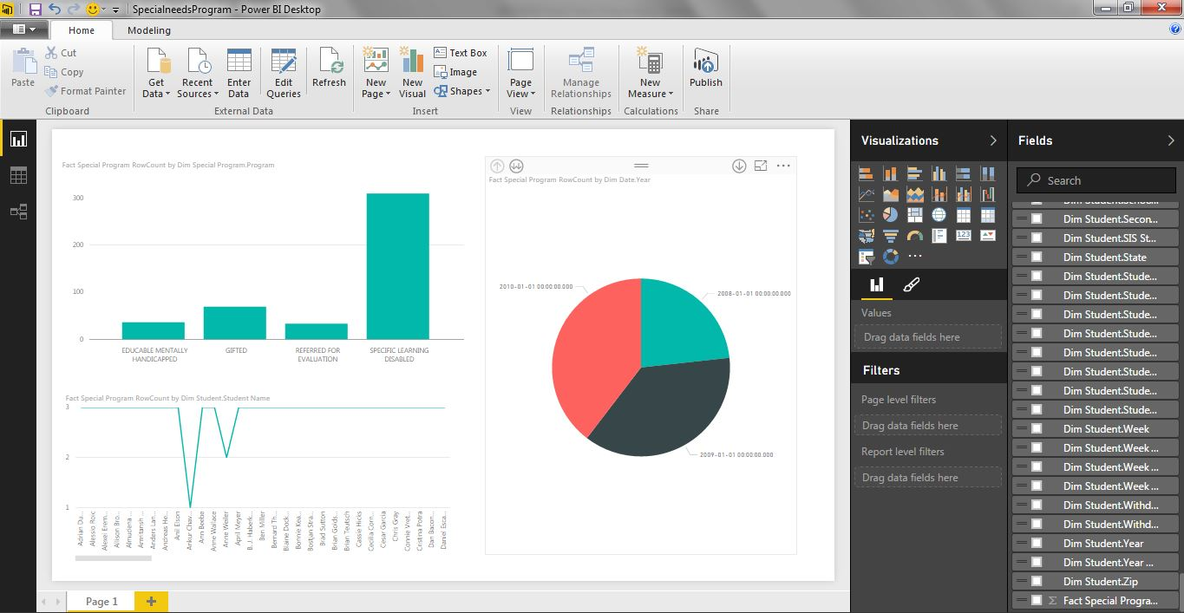
REPORT DEMO

